Slide 1
AliCoCo: Alibaba E-commerce Cognitive Concept Net
ADVISOR: JIA-LING KOH
PRESENTER: CHENG-WEI CHEN
SOURCE: SIGMOD’20
DATE: 2021/10/25

Slide 2
Outline
Introduction
Method
Experiment
Conclusion

Slide 3
Outline
Introduction
Problem
Previous Work
Target

Slide 4
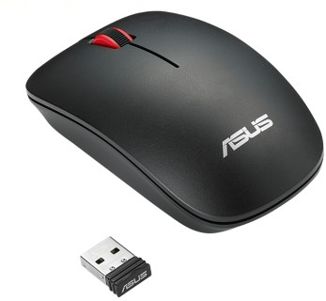
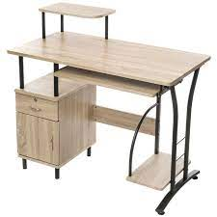
Problem
Category in E-commerce
Daily necessities
3C

Slide 5
Previous work
Existing taxonomies or ontologies in e-commerce are difficult to interpret various user needs accurately and comprehensively
Users do not always know the exact product. They have in mind is a type of products with some extra features.
Even worse, some users only have a scenario or a problem but no idea what items could help.

Slide 6
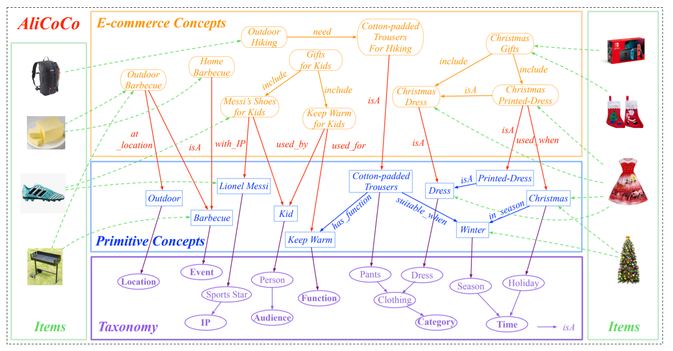
Target
Bridging concepts connect user and items to satisfy some high-level user needs or shopping scenarios such as “Outdoor Barbecue” and “Keep Warm for kids”

Slide 7
Outline
Introduction
Method
Experiment
Conclusion

Slide 8
Architecture
3
2
4
4
1

Slide 9
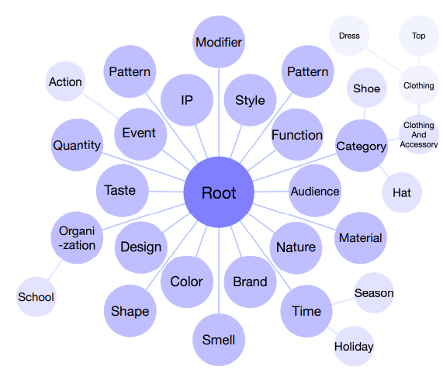
Taxonomy
1
20 pre-defined classes

Slide 10
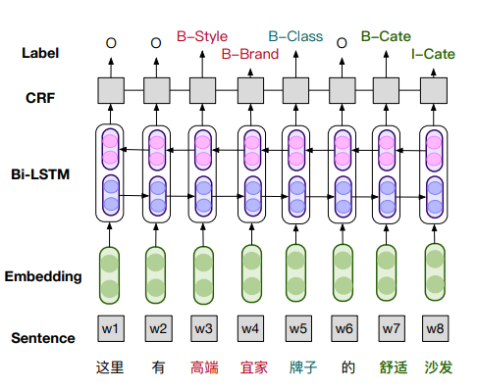
Primitive concepts
2
CRF labels:
B: Beginning
I: Interminate
O: Other
Sentence from:
Search queries
Product titles
User-written reviews
Shopping guide
Notes:
BiLSTM (Bidirectional-LSTM) enables the hidden states to capture both historical and future context information of the words
CRF (Conditional Random Field) considers the correlations between the current label and neighboring labels.

Slide 11
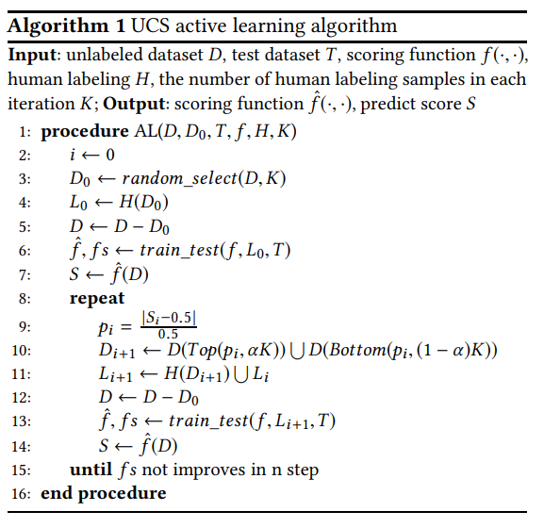
Primitive concepts
Taxonomy
2
1
select ->
human label ->
learning->
prediction
Uncertainty and high Confidence Sampling (UCS):
Choose prediction score of a sample is close to 0.5,
Choose prediction score of a sample is close to 1 or 0,
Notes:
it means the current model is difficult to judge the label of this sample. If the expert labels this example, the model can enhance its ability by learning this sample
believe those samples with high confidence are also helpful in the task

Slide 12
E-commerce concepts
3
Phrases from:
Search queries
Product titles
User-written reviews
Shopping guide
Criteria
E-commerce Meaning
Coherence
Plausibility
Clarity
Correctness
Adopt AutoPhrase to
mine possible concepts
Notes:
For the other four criteria, character-level and word-level language models and some heuristic rules are able to meet the goal

Slide 13
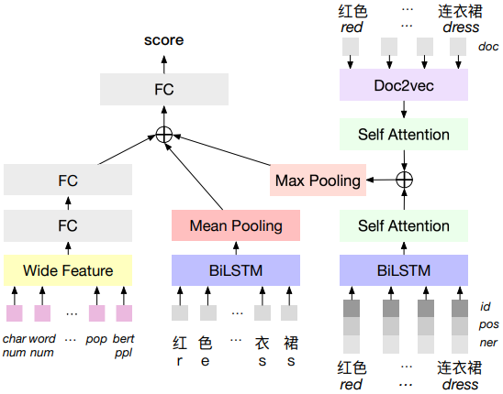
E-commerce concepts (Plausibility)
3
Pre-calculated feature to candidate concept
Number of words
Number of characters
Perplexity
Popularity in e-commerce scenario
ID: pre-trained word embedding
POS: Part Of Speech embedding
NER: Named Entity Recognition
character-based
word-based
Notes:
(Perplexity) https://medium.com/nlp-tsupei/perplexity%E6%98%AF%E4%BB%80%E9%BA%BC-426f52897513

Slide 14
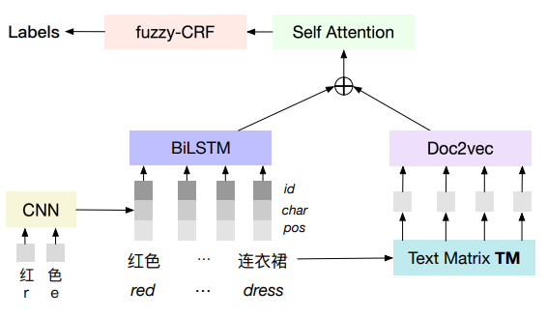
E-commerce concepts (tagging to Taxonomy )
3
1
Mapping each word back to large-scale text corpus to extract contexts and encode via Doc2vec

Slide 15
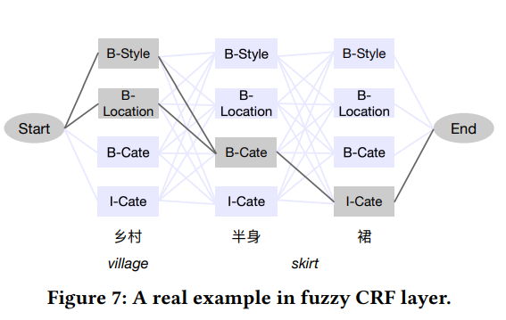
E-commerce concepts (tagging to Taxonomy )
3
1

Slide 16
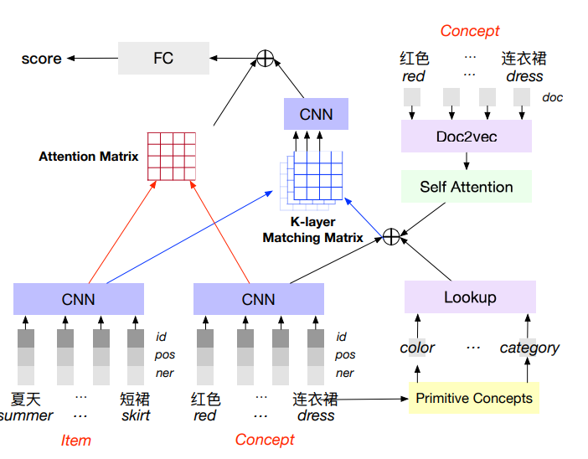
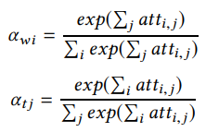
E-commerce concepts
Items
3

Slide 17
E-commerce concepts
Items
3
Concept embedding, Knowledge embedding, Primitive concepts class label ID

Slide 18
Outline
Introduction
Method
Experiment
Conclusion

Slide 19
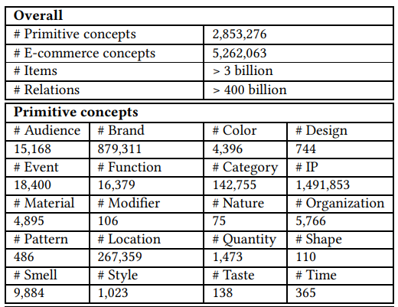
Dataset

Slide 20
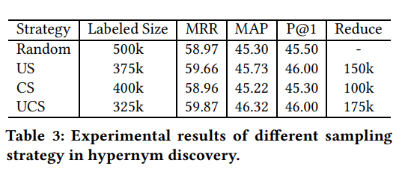
Experiment
Uncertainty and high Confidence Sampling (UCS, p11)

Slide 21
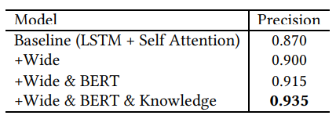
Experiment
E-commerce Concept Classification (p13)
E-commerce Concept Tagging (p14)

Slide 22
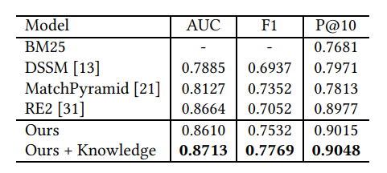
Experiment
Concept-Item Semantic Matching (p16)
Collect 200k positive pairs and 200k negative pairs as testing set.
Notes:
RE2: We explore what is sufficient to build a fast and well-performed text matching model and propose to keep three key features available for inter-sequence alignment: original point-wise features, previous aligned features, and contextual features while simplifying all the remaining components

Slide 23
Outline
Introduction
Method
Experiment
Conclusion

Slide 24
Conclusion
The “concept” nodes define user needs in e-commerce and build an end-to-end large comprehensive knowledge graph called “AliCoCo”,
To construct the four-layer structure of AliCoCo, we adopt a semi-automatic way by combining both machine learning efforts and manual efforts together.
Believe the idea of user needs understanding can be further applied in more e-commerce productions.

Slide 25
Notes:
Average Precision(AP)是：整組答案正確結果要優先出現的衡量指標，即：正確答案出現位置(多快多早)的整體衡量。
Reciprocal Rank (RR)是：第一個正確答案出現序位衡量指標，取之倒數。即：第一個正確答案多快(多早)出現？出現越早RR越高分。

